Slide 1

Columbian Immigrants
Name
Institutional Affiliation

Slide 2
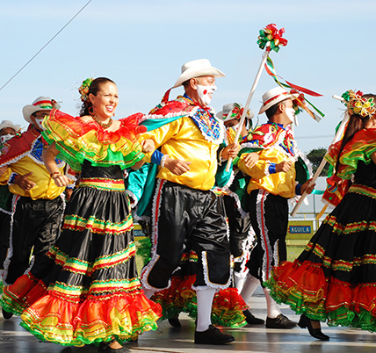
Introduction
Columbian Immigrants
Colombians represent a unique group of people originating from Colombia but have migrated to different parts of the world.
Columbians are known for their cultural diversity with its culture dating back to 1525 when the Spanish visited Colombia and subsequently colonized the country.
In the U.S., Colombians represent a group of Latin Americans whose culture and heritage are admirable.

Slide 3
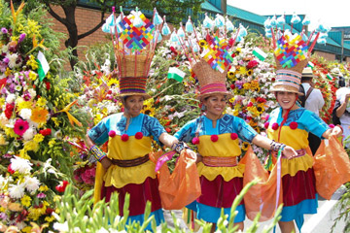
Identity
Self-determined
Social
Daring
Admirable
Adventurous
Happy
Polite
Creative
Patriotic
Fanatics
Notes:
Colombians have a unique identity that makes them admirable to other people. The self-determination among Colombians has seen most of them moving out of their countries to make a living and improve their livelihood. They are usually happy and happy something that makes them sociable. There love for coffee usually brings families together where they get to interact, share experiences and vouch ahead for better things to come (Pike 12) Colombians living in the U.S. are friendly and valuable social interactions and meetings that are directed towards keeping the unity of purpose and reminding themselves of what happens in the home country. These characteristics help them to keep the spirit of hard work.

Slide 4
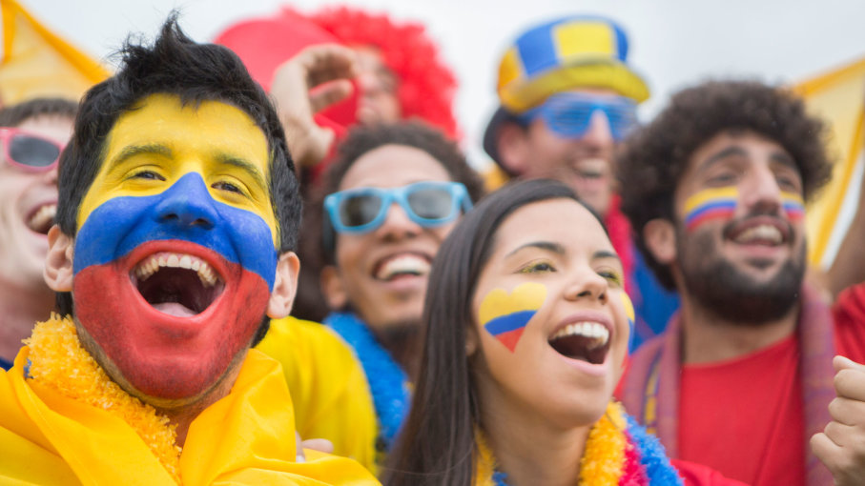
Identity Cont.
Self-determined
Social
Daring
Admirable
Adventurous
Happy
Polite
Creative
Patriotic
Fanatics
Notes:
It is easy to get along with a Colombian based on their daring nature. They like adventure something that motivates them to try out new things. Colombians are known to be patriotic and always conduct celebrations to mark their culture and important occasions in their country. Numerous Colombian festivals are celebrated even in the U.S. where these immigrant groups wear their cultural attire to show their identity (Pike 9). Sporting activities unite them something that shows that brings out the creativity in their fanatic nature. Colombians are known to be the best football fanatics and would even travel to other countries to support their national team.

Slide 5
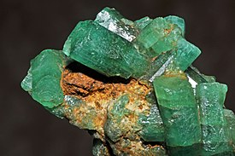
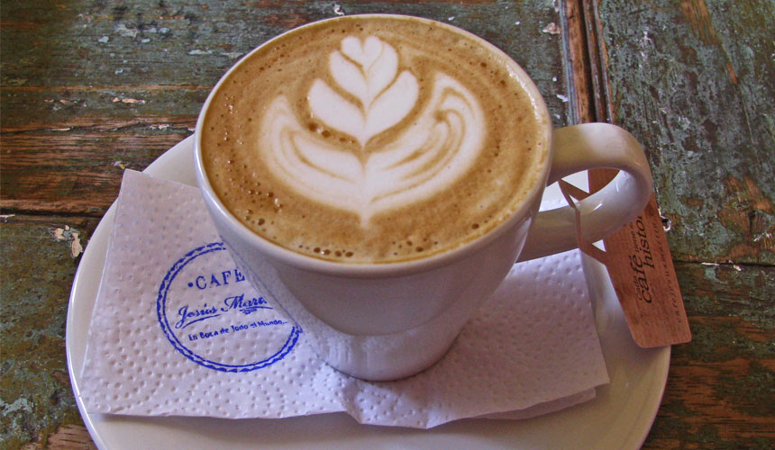
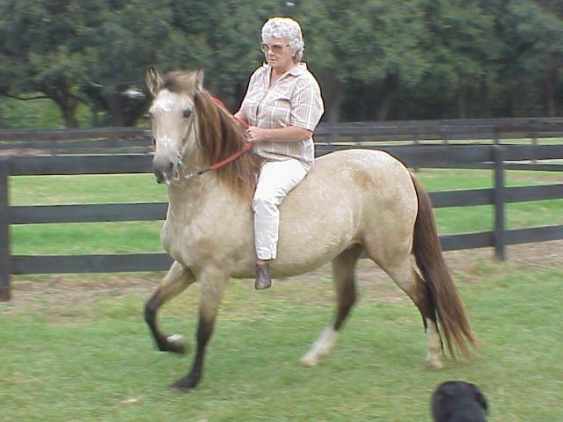
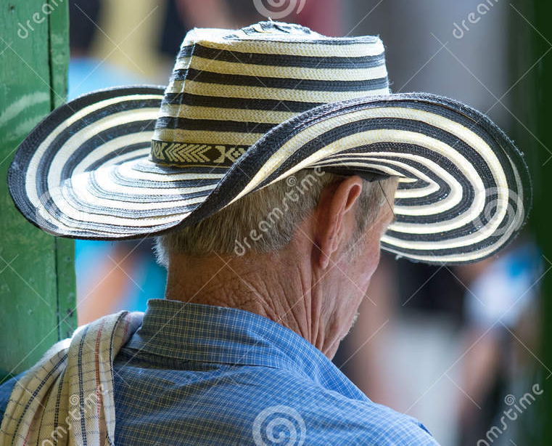

Material Culture
Emerald
There are unique objects that represent the Colombian culture that is synonymous to all Colombians. Colombian Coffee, Sombrero Vueltiao, Paso Fino, Emerald and Tejo
It is a precious Jewel found in Colombia.
It is available in large quantities in the mountainous regions.
Colombian Coffee
Paso Fino
Coffee is the national drink.
It is grown all over Colombia and is a major export.
It was introduced by the Spanish
It has become popular for transportation and also for sporting activities.
Sombrero Vueltiao
It is a unique hat representing the Colombian heritage.
It is locally made.
Tejo
It is the one of the popular sport in Colombia.
It attracts large number of people and has expanded to other countries
Notes:
Sombrero Vueltiao is the Colombian hat that is famous among the Colombian people. It is made through locally woven reeds and worn during national events and sporting activities. The indigenous Zenu people originally made the hat out of a particular type of cane. The hat can have different designs but has become popular among Columbians to date. Colombian coffee is an object that is globally known for its quality brand (Bell, para 6). In Colombia, coffee represents a cash crop that is grown in all the parts of the world. It is known as the drink that unites people together on different occasions.

Slide 6
Material Culture
Emerald
There are unique objects that represent the Colombian culture that is synonymous to all Colombians. Colombian Coffee, Sombrero Vueltiao, Paso Fino, Emerald and Tejo
It is a precious Jewel found in Colombia.
It is available in large quantities in the mountainous regions.
Colombian Coffee
Paso Fino
Coffee is the national drink.
It is grown all over Colombia and is a major export.
It was introduced by the Spanish
It has become popular for transportation and also for sporting activities.
Sombrero Vueltiao
It is a unique hat representing the Colombian heritage.
It is locally made.
Tejo
It is the one of the popular sport in Colombia.
It attracts large number of people and has expanded to other countries
Notes:
The Paso Fino is the Colombian horse that was introduced by the Spanish and has become a national symbol and also a means of transport. Tejo represents a sport that is popular and attractive sport which sees many people attending to look at the participants navigating through the tough challenges. Emerald is a jewel that is best known about Colombia (Miville 58). The Colombian emerald is considered one of the best in the world and was initially used for cultural practices. Even if the jewel is valuable, you can’t miss Colombians wearing jewels made out of emerald. The mining and commercialization are controlled by Colombians somethings that are still common to date.

Slide 7

Creation Story
The origin of Colombians traces back to the origin of emeralds
Muzo tribe which is considered to be the ancient and the origin of Colombians.
Are was the first man who created Tena and Fura.
Fura was a female married to Tena but eventually fell in love with Zarbi.
Fura cheated on Tena to Zarbi.
Tena was so bitter when he realized that the wife had cheated on her.
Emarald’s in the mountainous regions.
Notes:
The origin of Colombians traces back to the origin of emeralds. Muzo tribe which is considered to be the ancient where Are, the first man emerged along Magdalena River. Are created Tena and Fura through wood carvings and gave them life by the river. Fura and Tena represent humankind’s parents who else went ahead to be teachers of welfare, agriculture, crafts and arts. The two married but Fura cheated on his husband to Zarbi. Zarbi was an unusual being who lived in this region whose origin remains unknown. Zarbi is described to have had beards, and his hair was blonde (Colombian Mythology, para. 1).

Slide 8
Creation Myth cont.
The jealously made Tena to commit suicide which upon the discovery of the cheating spouse.
Tena lost his life and was buried even before Fura could return back.
These actions infuriated Are who was unpleased by all these happenings.
Upon return and learning of the death, Fura was left devastated.
She cried and shed tears for long but her acts were unforgivable.
She blamed herself for the death of his husband, and the tears could not stop rolling down her cheeks.
The unending tears shed by Fura upon the death of the husband is the origin of today’s emeralds.
Their son was not spared either as he was turned into a stone and placed in the middle of the river.
These rocks and stones are not just ordinary stones but are the emeralds found all over Colombia
Notes:
The jealously made Tena to commit suicide which upon the discovery, it made Fura to weep while shedding tears the death of his husband. As she tried to access his burial site, she was prevented. Are was not happy and turned Fura and the son into rocks These rocks and stones are not just ordinary stones but are the emeralds found all over Colombia (Colombian Mythology, para. 4). The unending tears shed by Fura upon the death of the husband is the origin of today’s emeralds The cause of these emeralds is linked to the early humans who were turned into rocks which makes them unique.

Slide 9
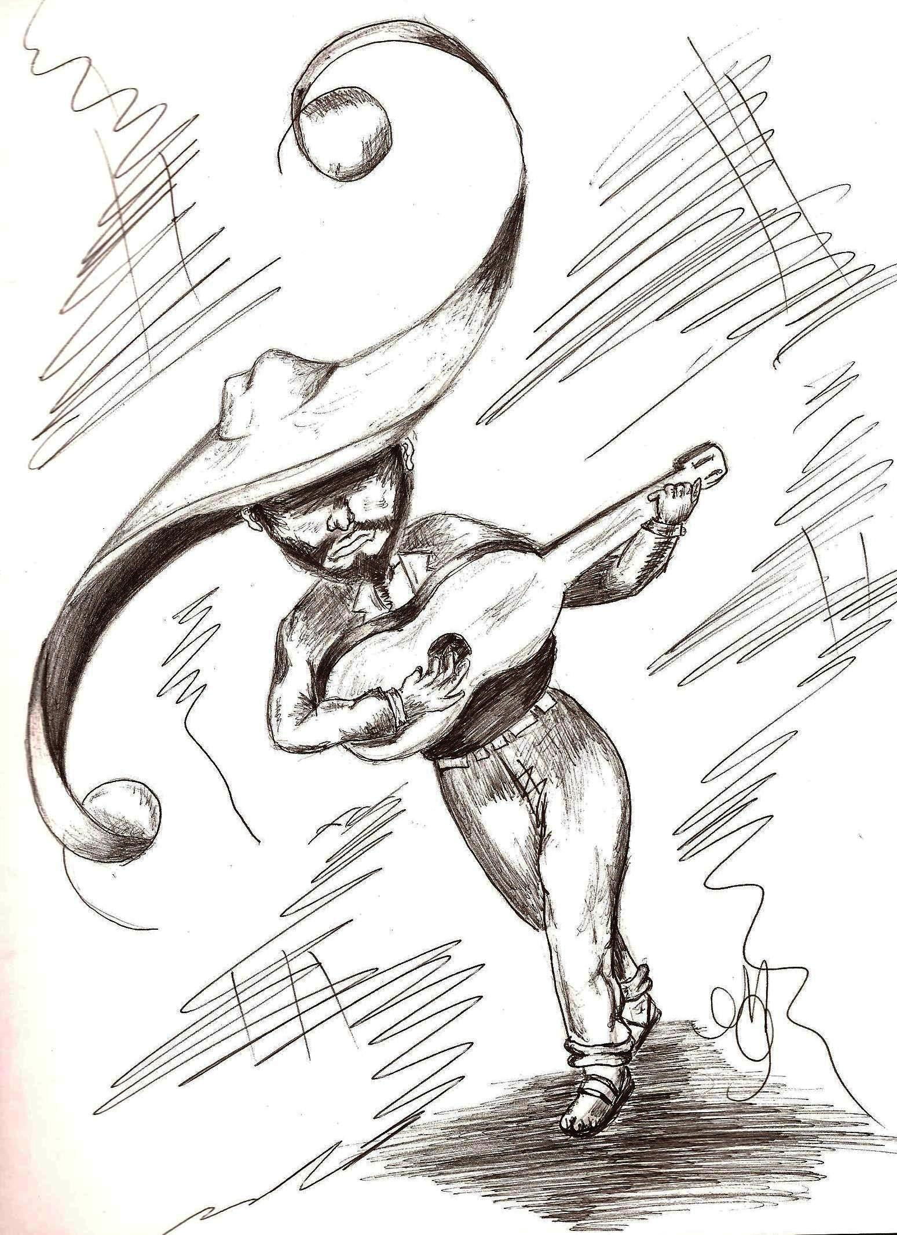
A Myth of Heroism
The El Sombrero is a known legendary icon from the country of Colombia.
After the death of this man, his spirit was left among the Colombians; representing terror to punish night wanderers and any other people who cause mischief to the society.
This icon is a representation of a great hope that Colombians will always have.
Their Sombrero hats culture has portrayed potential adoption as it transitions to blend the art of music, something that promises industrial growth.
This is a great achievement that warrants the Colombians of a certain economic growth.
Notes:
Colombia is overwhelmed by magic and mystery. The El Sombrero is a known legendary icon from the country of Colombia. After the death of this man, his spirit was left among the Colombians. In his duty to punish and is a representation of a great hope that Colombians will always have. With the fear that parents usually have of losing their children, especially girls to the pleasures of the world, Sombrero comes in to bring them to track. Their Sombrero hats culture has portrayed potential adoption as it transitions to blend the art of music, something that promises industrial growth (Obsorn, para 57). This is a great achievement that warrants the Colombians of a certain economic growth, from a simple culture aspect that is rooted to El Sombrero.

Slide 10

Hope for the Future
Having a “protective” spirit, Colombians have been able to engage in mighty deeds that bring value to them, fearlessly.
Evictions and external influences that Colombians are facing will end, given their superstitious culture.
Despite the harsh conditions, for instance, homelessness they face on their country.
There is hope that the spirit will work for them and establish paradise to them, this keeps them moving on.
Notes:
Having a “protective” spirit, Colombians have been able to engage in mighty deeds that bring value to them, fearlessly. Despite the harsh conditions, for instance, homelessness they face on their own continent, there is hope that the spirit will work for them and establish paradise to them, this keeps them moving on (Obsorn, para 55). Evictions and external influences that Colombians are facing will end, given their superstitious culture. It is these spirits that give people hope and perseverance of a better life to come. Whenever new challenges arise, Colombians usually have a conviction that the spirit living within them will help them overcome.

Slide 11
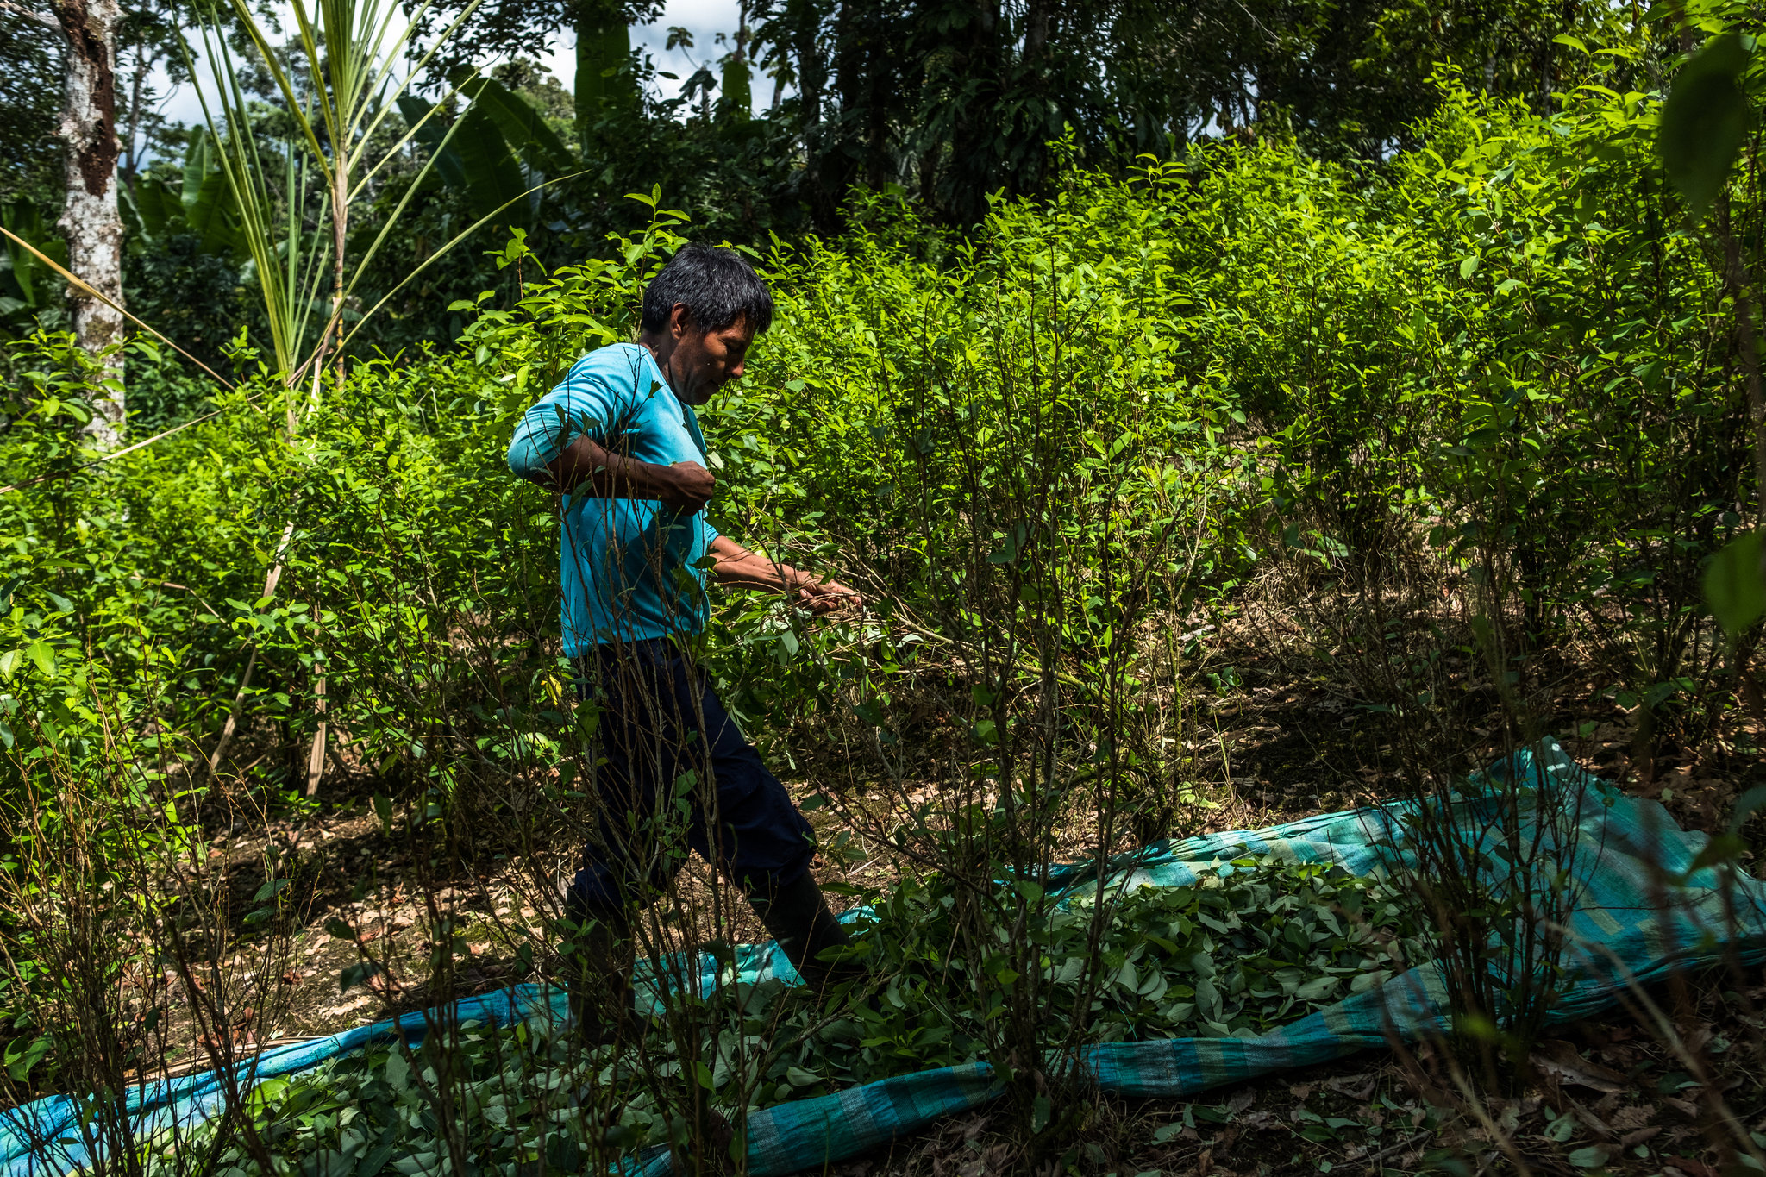
Hope for the Future Contd.
Natural systems are precious gifts that were endowed differently in different countries over the world.
El Moran is a Colombian monster whose work is to guard these natural endowments and any ancient treasure that the country has from his underground palace.
His role gives hope to the people knowing that their treasures cannot be interfered with, and any attempt would lead to the distraction of the concerned.
This monster is loved everyone because of his protection role.
Wherever you go, there will always be trust issues among men and their women.
Colombian men have a way of dealing with such cases; scaring their women off unfaithfulness and other issues that weaken family values.
La Pasatola, One-Legged-Woman in the jungle entices men who fall out of her beauty and smart hair and eventually turns to murder them sucking their blood.
This La pasatola, therefore, builds the hope for the functionality of all marriages/families in Colombia despite the problems they face.
Notes:
Natural systems are precious gifts that were endowed differently in different countries over the world. El Moran is a Colombian monster whose work is to guard these natural endowments and any ancient treasure that the country has from his underground palace (Pike, 14). Wherever you go, there will always be trust issues among men and their women. La Pasatola, One-Legged-Woman in the jungle entices men who fall out of her beauty and smart hair and eventually turns to murder them sucking their blood. This La pasatola, therefore, builds the hope for the functionality of all marriages/families in Colombia despite the problems they face (Obsorn, par. 57).

Slide 12
Works Citied
Bell, Chris. Is Coffee the Secret to Colombia’s Happiness? Culture Trip. (2017, Sept 11).Retrieved from https://theculturetrip.com/south-america/colombia/articles/is-coffee-the-secret-to-colombias-happiness/
Colombian Mythology. The Origin of Emeralds. (2010). Retrieved from http://winners.virtualclassroom.org/0914/samerica/col02.html#top
Miville, Marie L., et al. "Colombians in the United States: History, values, and challenges." Latinx Immigrants. Springer, Cham, 2018. 53-73.
Osborn, Ann. Mythology and social structure among the U'Wa of Colombia. Diss. University of Oxford, 1982.
Pike, Fredrick B. The United States and Latin America: myths and stereotypes of civilization and nature. University of Texas Press, 2010.

